Slide 1
Practical UX
When You Have (almost) No Time or Money
Notes:
Welcome to the session on Practical UX: When you have almost no time or money.

Slide 2
What We Will Cover
Why?
User research options
Different types of user testing
Notes:
Today we are going to talk mostly about doing user research and user testing through the lens of not having a lot of money or time in which to do it. We’ll talk of course about why we do it as well.

Slide 3
About me
Gwen Daniels
Software Product Director
Illinois Legal Aid Online
Twitter/Drupal.org: gadaniels72
Notes:
I'm Gwen Daniels. I'm the software product director for Illinois Legal Aid Online here in Chicago. I was primarily a Drupal back-end developer and project manager up until July of last year. Now I'm focused much more on UX and serving as the product owner for IllinoisLegalAid.org and managing our development team. I'm on Twitter and Drupal.org as gadaniels72.

Slide 4
About ILAO
IllinoisLegalAid.org (built on Drupal 7; launched Aug 1, 2016)
Designed primarily for lower-income users who need to solve a civil legal problem and can’t afford a lawyer
As a non-profit, we have limited $$$ to do anything
Notes:
I work for a non-profit here in Chicago, Illinois Legal Aid Online. Our website is Illinois Legal Aid .org and is built on Drupal 7. It’s focus is to provide legal information and services to those who have civil legal problems and can’t afford a lawyer. As you probably know, in criminal matters, one is entitled to a lawyer regardless of whether or not you can afford it. That’s not true for non-criminal issues like wage theft, child support, divorce, getting an order of protection from abuse, identity theft, consumer issues, or eviction and other housing matters. That’s where our website comes in. As a non-profit though, we have limited resources but our users depend on us as often their only resource to securing justice.

Slide 5
Quick Credits
Special thank you to:
Aileen Macariola, ILAO’s UX Research Coordinator VISTA
Angela Tripp, Director of Michigan Legal Help
Emily Good, Minnesota Legal Services
Notes:
I also want to do a little shoutout to three people without whom this presentation wouldn’t be happening. First is Aileen Macariola (sitting here) who is our UX research coordinator VISTA. She does all of our user testing and much of our research. Angela Tripp, the director of Michigan Legal Help (similar to our site only for Michigan residents) and Emily Good who manages a similar project in Minnesota also contributed to this presentation.

Slide 6
Why care about UX?
You only get 1 chance to make a first impression
Depending on the website’s purpose, a bad UX can:
Damage your brand & reputation
Cost your company money
Frustrate your user
Harm your user
Notes:
So why do we care about the user experience? It’s really simple: we only have 1 shot with users. If they come to our site, we often have just a few seconds to convince them we have something of value for them. If they have to think too hard or can’t easily tell if your site answers their question or gets them what they needs, they’ll go somewhere else.
And that’s something that can really cost us and the user. It can damage your brand, your reputation and in some cases it can harm the user.

Slide 7
User Research
Who am I building for?
Notes:
So let’s dive in first to user research.
What do we mean by user research? understanding user behaviors, needs, and motivations through observation techniques, task analysis, and other feedback methodologies
This is something that doesn’t have to cost any money to do. It doesn’t even have to take a lot of time. It can, depending on how in-depth you want to do your research but there’s a lot of “easy” wins when it comes to research.

Slide 8
What do you already collect?
Google analytics
User feedback surveys
Contact us forms and email
Notes:
Think about things you already collect on your website. Do you use Google analytics? What about adding a feedback survey if you do not already have one? Do your users contact you via email? If you have any of these then you know something about your users. If not, what about log files? Years ago, we had an intern go through raw log files and track user flow to see how users interacted with our website.
This was 2004-2005 before Google analytics and he was able to go through user's path flows and tell us no one ever sees your home page.

Slide 9
Google analytics: Basic Data
Where are your users located?
How long do they stay on your website?
How are they getting to your site?
What are they using to get to your site?
What are they looking at once they are there?
Notes:
Let’s talk about some of what Google analytics can give you to form some basic user research. Just by adding the code to your website, you get a lot of basic data:

Slide 10
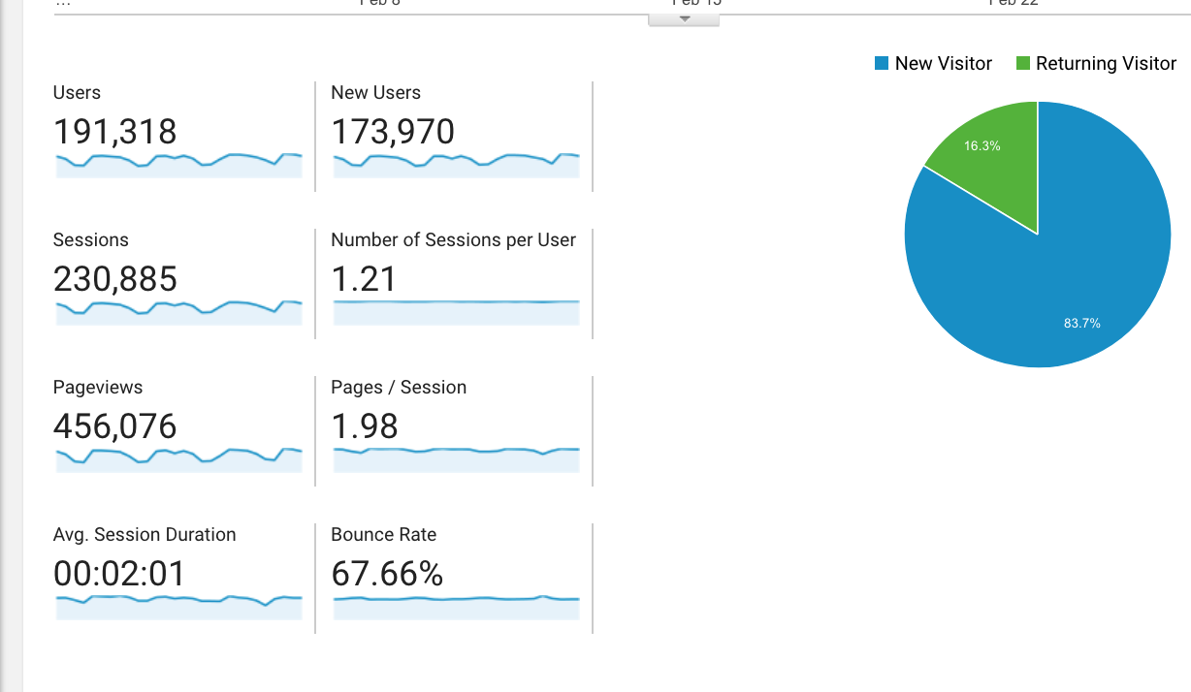
Notes:
Basic data can tell us a lot about our users: how many are there? How long are they staying? Are they returning users?

Slide 11
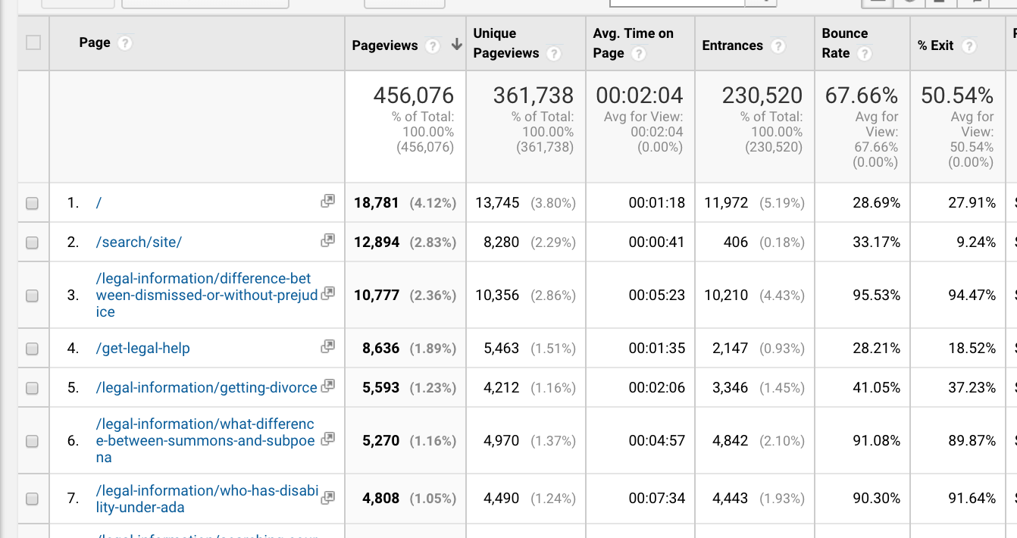
Notes:
It can show us what they are looking at and what happens when they look at a page. Knowing what pages your website users spend time on can help you prioritize. On our website, 75%-80% of our page views are to our legal information pages versus content for lawyers and referrals. That’s where we put a lot of our resources and focus.
It can also give you glimpses into our users. For example, the difference between dismissed with and without prejudice, which indicates whether someone can refile a dismissed lawsuit or not, is very popular. If I dig deeper, I can tell you it is less popular if I filter on Illinois users. But it’s telling too that a lot of users view the page, spend up to 5 minutes on it and then leave the website. We aren’t enticing them to stay on the site. They get their answer, we hope, and are done.
So being able to see that kind of information can be very helpful to understanding what your users are doing.

Slide 12
Google analytics: Demographics Data
Age
Gender
Interests
Must be enabled (ensure your site privacy policy allows this)
Notes:
Google also will share demographic data with you. You do have to specifically enable it and there are privacy issues around this. You’ll want to make sure your site’s privacy policy allows you to enable it. I know we went back to our pro bono counsel to update our privacy policy before we enabled this.

Slide 13
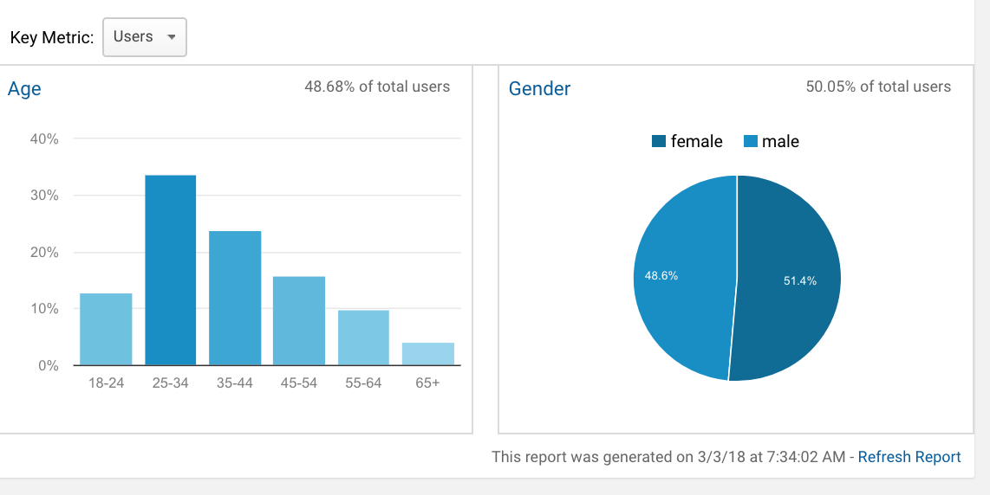
Notes:
But it then allows you to see the gender, age, and interests of your users.

Slide 14
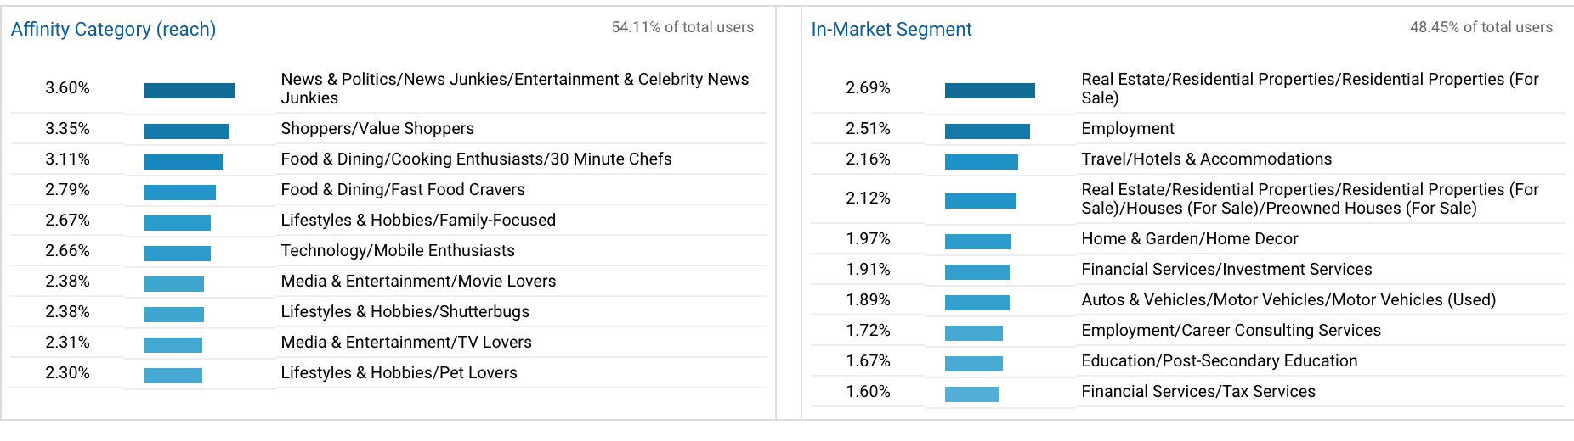
Notes:
Interests track across web visits and allows you to see what Google thinks your users are also interested in. Keep in mind though that this data is not always collectible; it depends on cookies and privacy settings. We get about 50% of our users. You can use this demographic data to then filter sessions or page views and think about connections.
For example, is there a relationship between legal issues and age? I'd expect a higher relationship to nursing home content and seniors than other users and for DACA or education rights for younger users.

Slide 15
Google analytics User explorer
Allows us to follow a user through repeated sessions on the website
Can be useful in developing personas
Notes:
Then there is the User explorer. This is one of the most interesting tools I’ve worked with but it does require time and patience to sift through. Google can track what it perceives as a single user and allow us to see how they’ve interacted with the web site across time. We’ve used this to create user personas as it is an incredibly easy way to envision a user using the website.
It is far faster and cheaper than conducting interviews with users.

Slide 16
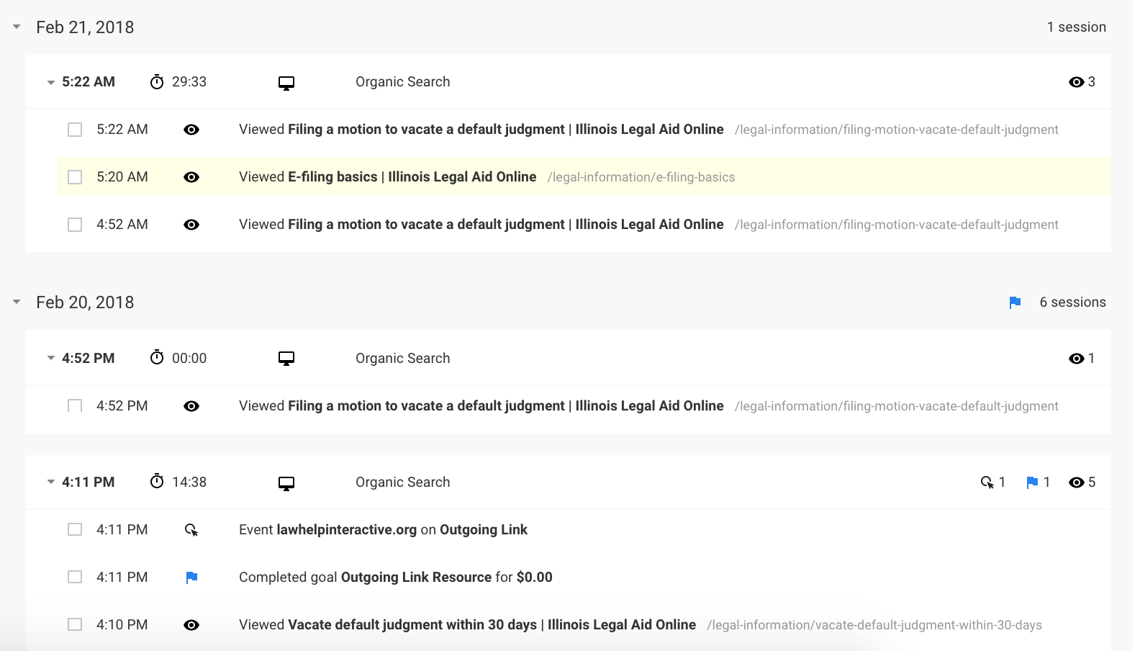
Notes:
So here’s an example, we have someone who visited the website and landed on our vacate default judgement content. We have an event created that tracks outgoing links. This user clicked one that happens to go to a partner website, LawHelp Interactive, that hosts our company’s free online automated documents. The user then came back to the same piece of content. Over the nexxt few days, the user returned and looked up information on how to e-file…

Slide 17
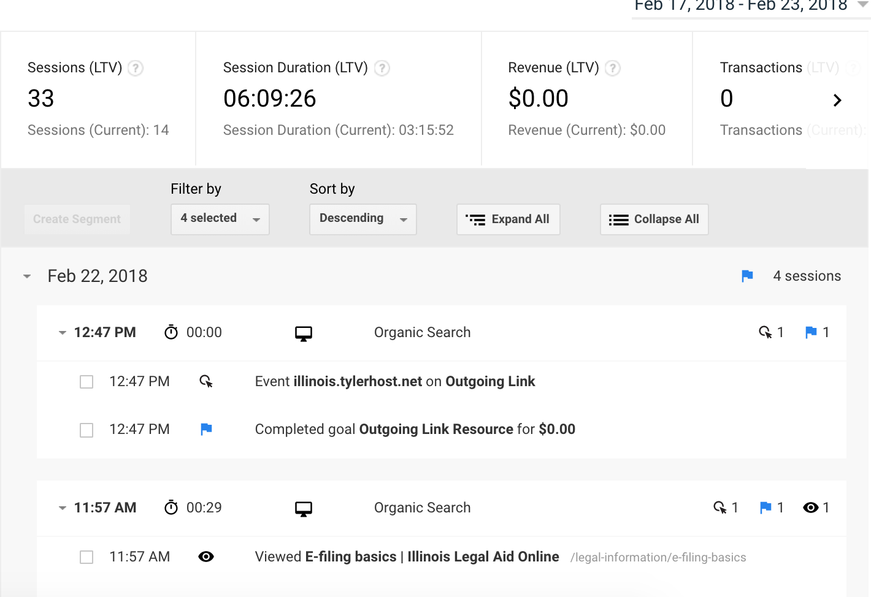
Notes:
And then landed back on our site and finally landed on Tyler Technologies, which provides e-filing for courts here in Illinois. Looking at this data, it’s realistic to assume the following scenario: The user failed to appear in court and had a default judgment entered against them. He then came to our website, found our automated forms to contest the default judgement, completed those on Law Help Interactive, returned to our site to learn how to e-file and then went to Tyler to actually e-file.
That’s a whole lot of user information that I gleaned in about 5 minutes for free. It’s all there; we just need to make use of it.

Slide 18
User feedback surveys
Keep it short:
Would you recommend this to a friend?
What brought you to the website?
How hard was it to find what you were looking for?
Can we contact you?
ILAO’s feedback survey: https://www.surveymonkey.com/r/NLLXK6V
Notes:
Feedback surveys can be a great way to get to know a little bit about users…and to gather contact information so you can follow up with more in-depth conversations.
It’s really important with feedback surveys to keep them short. Ours has 4 questions. It tells us just enough to give us an idea of who is using our site and the ”Can we contact you” gives us users’ contact details so we can follow up with email or by phone and follow up with more in-depth questions.

Slide 19
Contact Us & Emails
Why are users contacting you? Are there common themes?
Can you follow up with any of these users to learn more about their experience using the website.
Notes:
If your website has a contact us form that goes into a folder, database or to e-mail you have a wealth of user data. You have feedback from users, their email address (most likely) and why they contacted you It’s often more time consuming to track but the data is there.
Look for common themes: we have a lot of folks who use our contact form because they are looking for legal help. We auto-direct them to the right resources but it helps us identify what legal problems people are reaching out for...do we have enough content for those? Are they hard to find? Should we do more testing on those?

Slide 20
Engaging recruited users
User joins site or fills out our feedback survey
Follow up with an automated link to a data survey
When doing tests, combine user data from Drupal with survey data (on email) to filter participants who match
Notes:
Another thing we do, because we do let people join the site, is ask them if they want to be part of future user studies. It’s just a simple yes/no box on our registration form. That has given us a list of over 900 users we can easily reach out to.
One area where we’ve failed, really where I’ve failed, is in keeping those users engaged and ensuring that we have metadata on our users. Thankfully Aileen looked at the procedures former staff were using and has given us a way to automate parts of the engagement process: after they sign up on the site, a few days later they get a user survey asking some follow up questions like how comfortable are they using technology? What’s their education background? How do they access the internet? Combined with profile data on our website, tied together by email address with the survey data, we can then target testing to specific segments. We’re working on defining additional follow up to keep these potential testers engaged.

Slide 21
What Do I Do With This Research?
Define action steps if the research uncovers problems
Help prioritize where to test
Help identify users and user segments for testing
Use to develop personas to guide future development
Notes:
So once we’ve collected this research and looked at it, it doesn’t do any good if we don’t do something with it.
Does reviewing the Google analytics data show gaps in the website’s content? Define action steps to take.
Are there pages that have unexpected data? High bounce rates where you wouldn’t expect? Long time on short pages? Are you getting feedback that users are struggling with particular tasks? Use those to prioritize testing
Are you learning that your users are accessing the site in ways you didn’t contemplate or ever test for? Is mobile now 50% of your traffic yet you only ever tested on desktop? Are people’s paths unusual in your opinion?
Finally, developing personas can give you someone to relate to in development. Instead of ”I’m building this site for users with legal problems,” I can say “Im building this site for Cristina, who is in a legal crisis and searching for help with domestic violence.” She is one of ILAO’s personas. For me, thinking about specific “users” can spark my brain differently than trying to solve an abstract problem.

Slide 22
User Testing Options
Are we getting it right?
Notes:
So now that we’ve covered research, let’s talk about user testing. Testing is critical in software development and user testing is a very important piece. I have found as a developer time and time again that while ”it works for me” when I put it in front of a user, they might not understand what I meant for them to do.

Slide 23
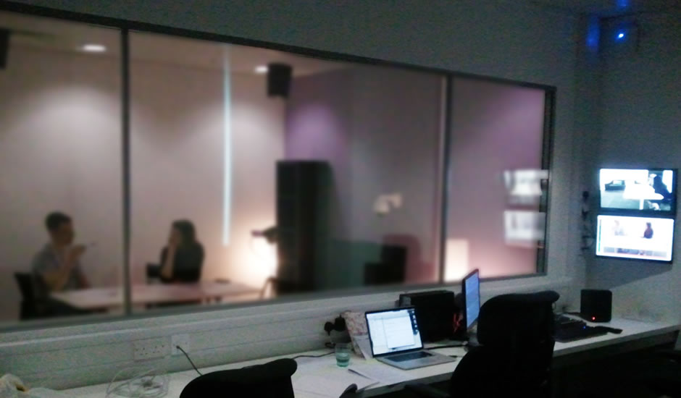
Notes:
User testing doesn’t have to be expensive and it doesn’t have to be as formal as the image here with a window where observers can secretly watch a facilitator guide a user through a set of tasks. Sure, if we have the time and budget to do that, great. But there are many types of user testing and many free and cheap ways to do it. So let’s talk about those.

Slide 24
Questions to consider with every test
What are we testing?
Why are we testing?
What users are we testing for?
What is our timeline?
What’s my budget?
Notes:
First, there are a few things to think about when you start thinking about testing:
What are we testing? What we test will often drive the type of test you do. If you want to test whether users can find information on your site, a card sort or tree sort may work best. If you want to see if users can complete complex tasks, a long form observation test will likely be required.
Why are we testing? What are our research goals? It’s very difficult to test if you don’t know what you are testing for. Are we trying to find out if a change will spark an increase in user engagement or where the best location for an icon is? Defining our goals is a key for any user test.
What users? This is usually not too hard to figure out but if you have a site like ours with multiple audiences, it’s important to think about who your target users for the test is. Also, do you care about demographic information? Education or skill level? Device type?
Timeline. This can also impact what you test and how. We’ve had a couple of situations with very tight timelines. In those instances, it was more efficient for us to use an online test and pay the platform to find users for us rather than to try and actively recruit.
Budget. Again, this plays a role. Maybe you’d like to do in person observation testing but can’t afford to pay users for their time, but you can narrow your testing to a short form that people will more likely do for free.
So let’s get into some different types of testing…

Slide 25
Five Second Tests
Notes:
The five second test is exactly what it sounds like: put an image of a web page in front of a user for 5 seconds, hide the image and ask some questions about what they recall.

Slide 26
Purpose
Does the page make a good impression?
Can the user tell who you are and what you do?
Do they see anything of value for them?
Do call to action items stand up?
Do users notice navigation items?
Notes:
It allows us to find out if in the limited amount of time we have to make a first impression, are users getting what we want them to get: who we are, what the site can do for them. Do they notice calls to action or navigation options?

Slide 27
How to do five second test
Sketch
Paper prototype
Online
Free with Usability Hub
Free with Optimal Workshop
Notes:
There are many ways to do these tests. We did these out on the streets of downtown Chicago. Just stopping people and asking if they’d look at the page for a few seconds and answer a couple questions. Not everyone would but we got enough results in an afternoon.
You can also do these online for free at UsabilityHub and Optimal workshop.

Slide 28
Navigation Tests
Card sorts and tree tests
Notes:
Another type of testing is to test navigation. While you can test it within the context of your web pages, if what you want to test is the paths and the labels, card and tree sorts are your best bet because they strip away all elements of design and user interface.

Slide 29
Purpose
Test navigation independent of design
Card sorts for labels
Tree sorts for navigation path
Notes:
Card sorts test your labels: given a set of pages, pieces of content, will users group them the same way you did? For that you’d do a closed card sort where the user must put the pages into groups of labels you provide.
Or you can do an open card sort where you give the users a set of pages and ask them to group and label them.
Tree sorts are kind of the opposite---you’ve already grouped and labeled the pages and now you want to give users tasks to find their way to the page
With tree testing, you give the user a task “Find the time Sunday’s sprint start” or “Find the address for the party tonight” on the MidCamp website. And then provide the possible navigation paths…and users drill down through a navigation tree until they reach the category they would expect to find the information.

Slide 30
How To Test Navigation
Card sorts
With paper or index cards
Online for free with Optimal Workshop
Tree tests
Excel or spreadsheets
Online for free with Optimal Workshop
Notes:
Card sorts can be done incredibly easily with just index cards. Tree sorts can be done with a spreadsheet and asking the user to highlight their route.
Or you can do them online using the free plan from Optimal Workshop, which is what we did.

Slide 31
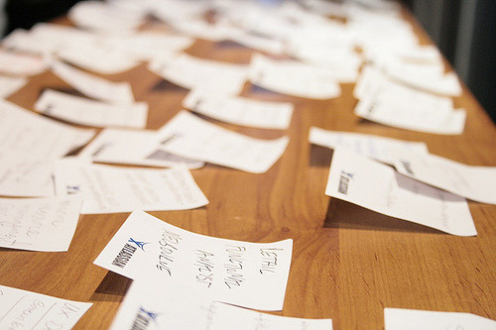
https://www.flickr.com/photos/cannedtuna/1423599488
Notes:
Card sorts can be done on paper or index cards. Nothing high tech and index cards are cheap. Just label them with your content titles and let your users group them.

Slide 32
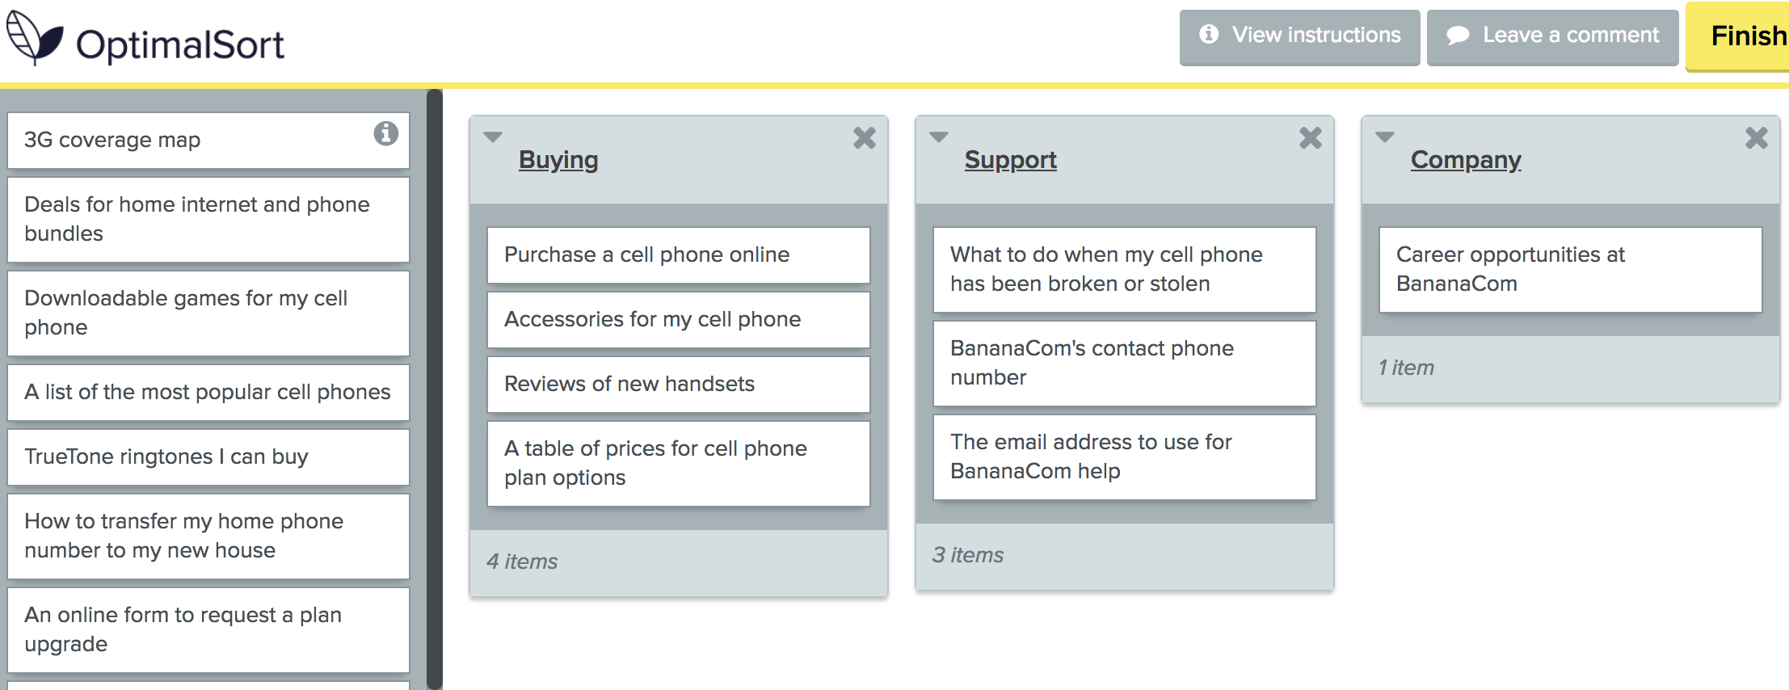
Notes:
Or you can do them online. Optimal Workshop for example, allows for card sorts with up to 30 cards with their free plan.

Slide 33
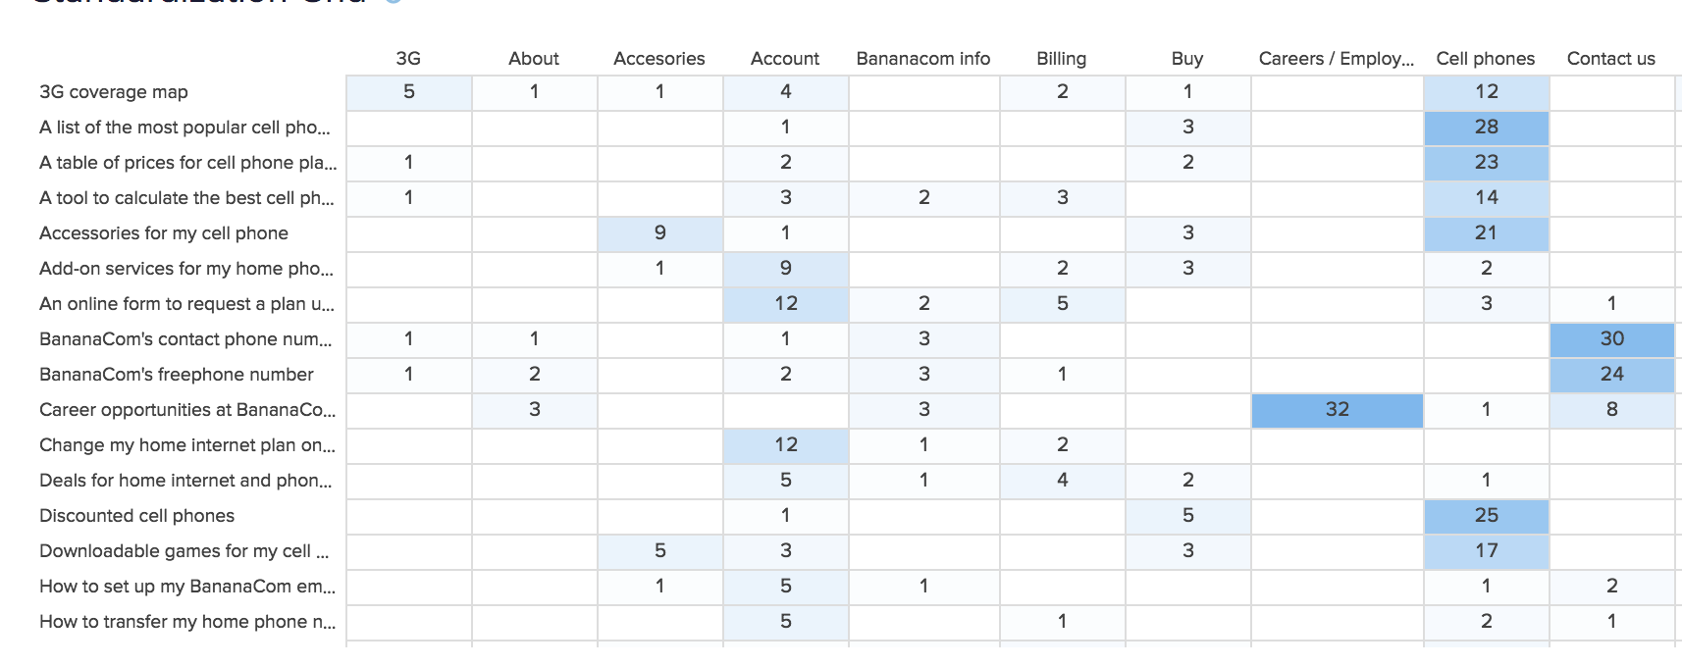
Notes:
And then their tools provide free analysis options.

Slide 34
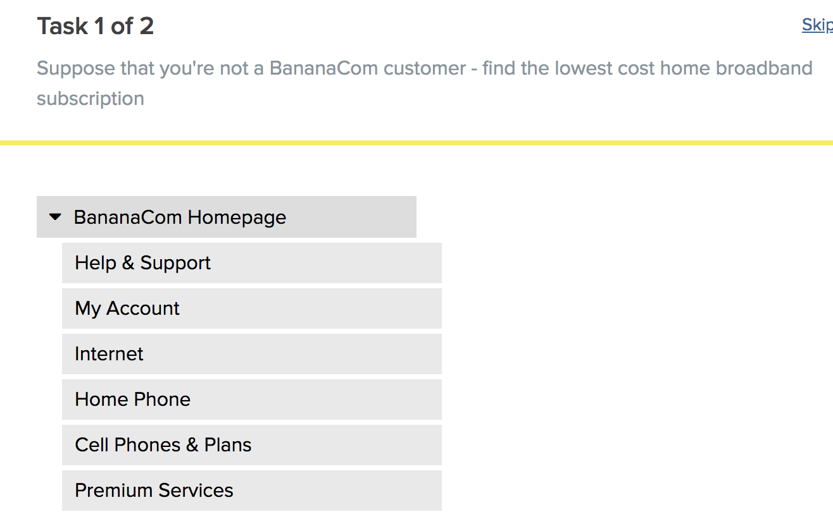
Notes:
You can also use Optimal Workshop for free tree sorts.

Slide 35
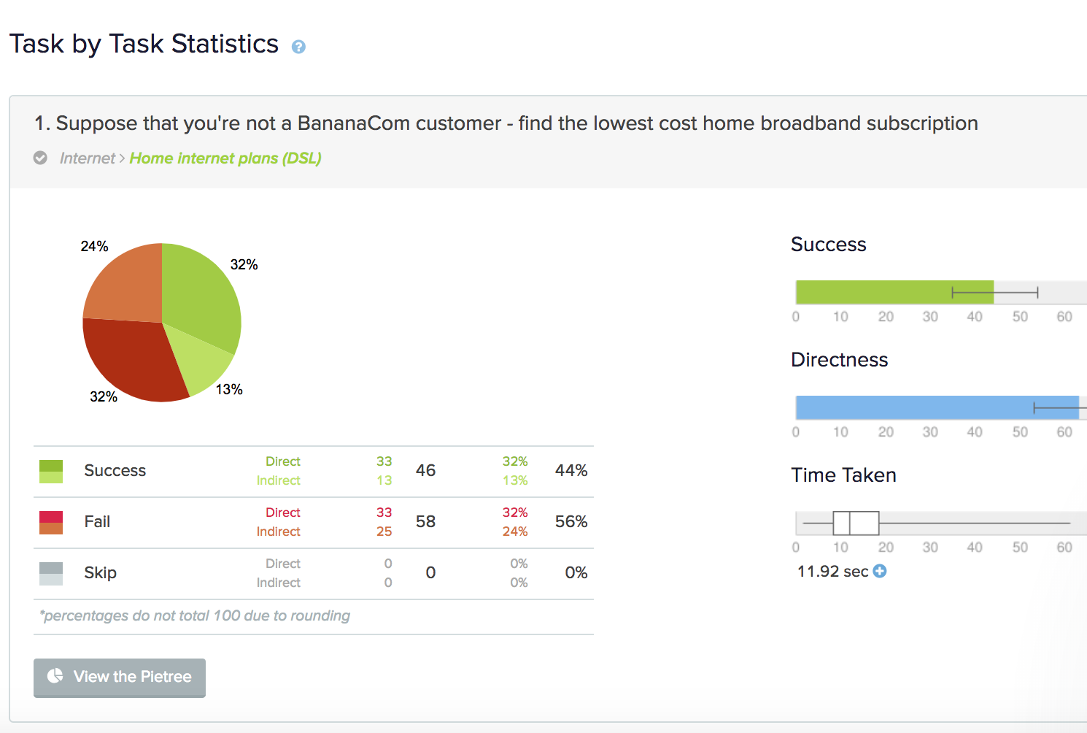

Slide 36
First click tests
Notes:
First-click tests display an image of a web page and a task. The test-taker clicks on that part of the web page (link, graphic, menu, etc.) that they think will help them complete the task.
There's no opportunity to clarify the task so the task needs to be concise and simple.

Slide 37
Purpose
To ensure that users get that first click right when completing a task
87% will get their task completed if they get the first click right
46% will fail if they don’t
Notes:
It’s an important test because if you get the first click wrong, the risk of task failures are huge compared to getting it right.

Slide 38
How To Do A First Click Test
Paper prototype: where would you click to do this?
Online for free
Usability Hub
Optimal Workshop
Notes:
Like navigation testing, these can be done on paper with a sketch or a prototype or online with an image and a service that will capture that first click.

Slide 39
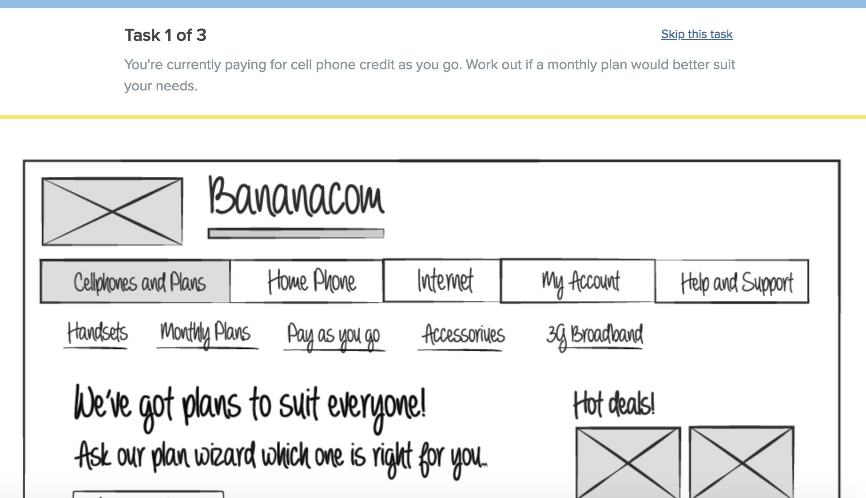
Notes:
Also free with Optimal Workshop’s free plan. Limited to 3 tasks. Limited to 10 responses

Slide 40
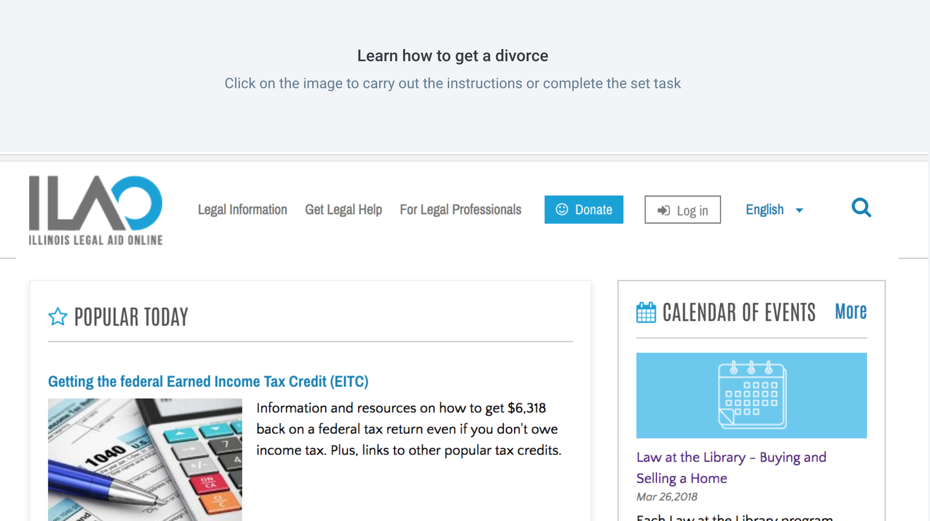
Notes:
UsabilityHub also has a free plan that allows you to do first click tests.

Slide 41
A/B Testing
Notes:
A/B Testing is another form of user testing. And it’s not really just A/B. I ran one recently that was A,B,C,D,E. The idea though is to show a percentage of your users 1 version and another group a 2nd version and see which works better.

Slide 42
Purpose
Let’s you see with two or more variants, which results in greatest improvement:
Lower bounce rates
More pages viewed
More conversions
Notes:
Some things one can look for are:
1) With which variant did users click where we expected to for a specific task?
2) Does one variant result in better user engagement by looking at bounce rates, page views, session duration?
3) Does one variant result in more conversions? A sale on an e-commerce site or a click to a specific call to action?

Slide 43
How to A/B Test
Websites
Google Optimize (free for 3 tests at a time)
Easy to use visual editor
Virtual Website Optimizer (vwo.com)
starts at $49/$59 per month
Additional features
Drupal A/B testing module
Mail
Mailchimp supports A/B testing of emails
Notes:
You can do A/B testing with your website using at least a couple of tools:
--Google optimize, which is what we use
--Virtual website optimizer, which works similarly to Google optimize
--Drupal A/B JavaScript module, which I have not used.
I also want to mention, because we also do email campaigns, that Mailchimp can also support A/B testing.

Slide 44
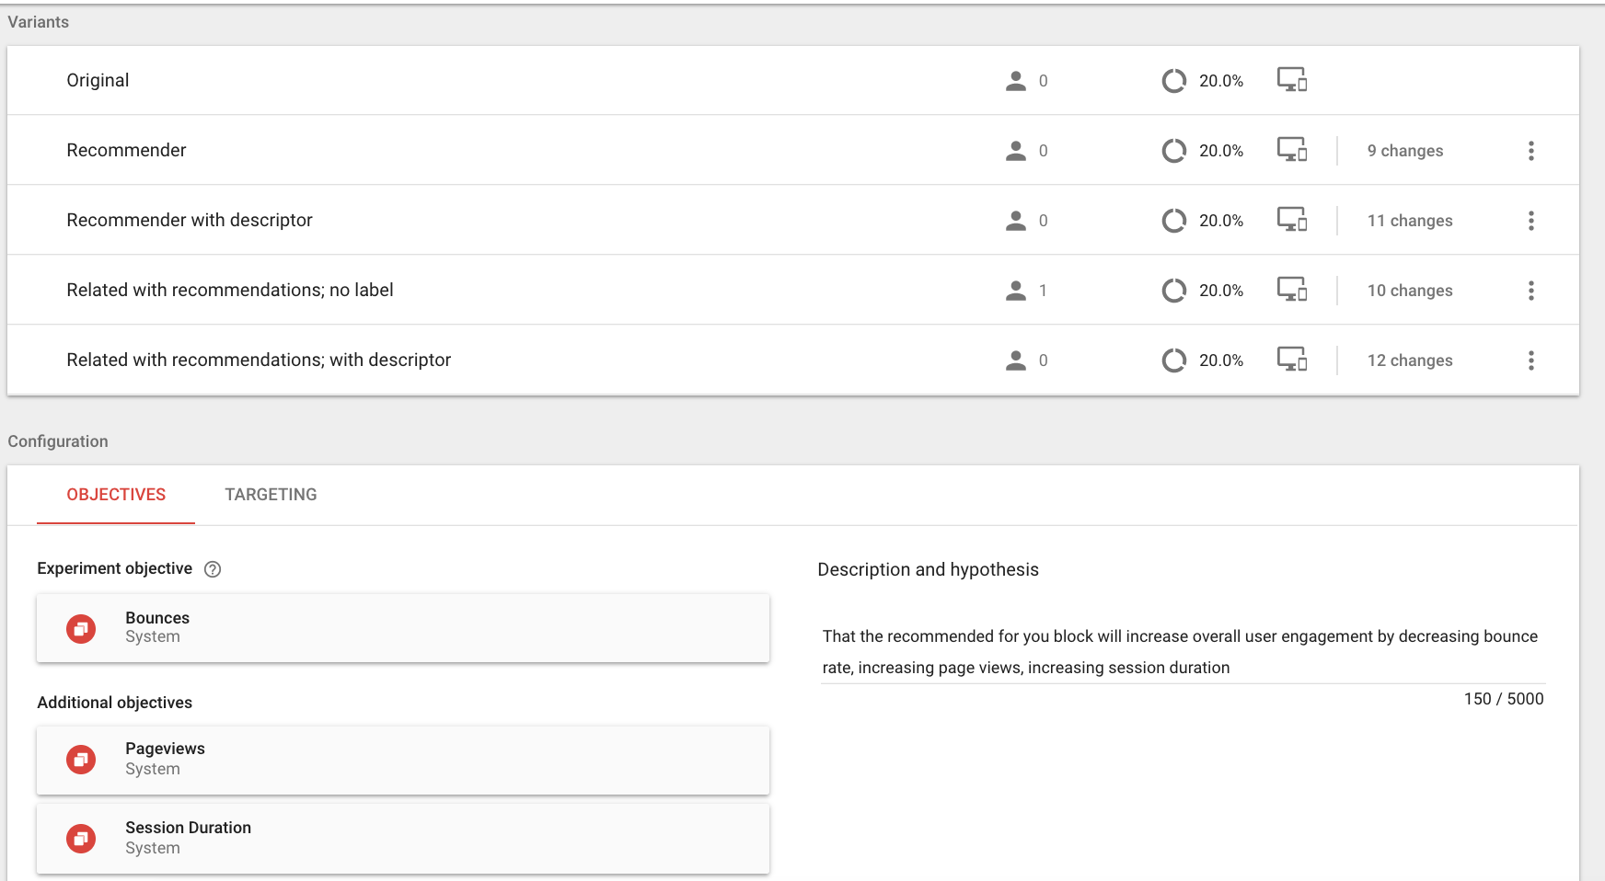
Notes:
So let me show you quickly what I can do with Google optimize. I can create a test by providing a link and then create a variant. Google optimize has a Chrome plug in that allows me to easily edit an existing page to replace content. For example, we ran a test recently that replaced a Related block with 3 hand-picked items with a Recommended for you block that used a machine learning algorithm to select the results. I went in, edited the page in the browser, and saved the variant.
Like Google analytics, it does require adding a tag to your website. But it can really slow down a site. You do not want this to run on all your pages. What we ended up doing, and we are a Drupal 7 site, was to inject that script only on specific template files by creating node-specific template files.
. Google optimize automatically shows users a random variant and it can remember which variant a repeat user has seen.

Slide 45
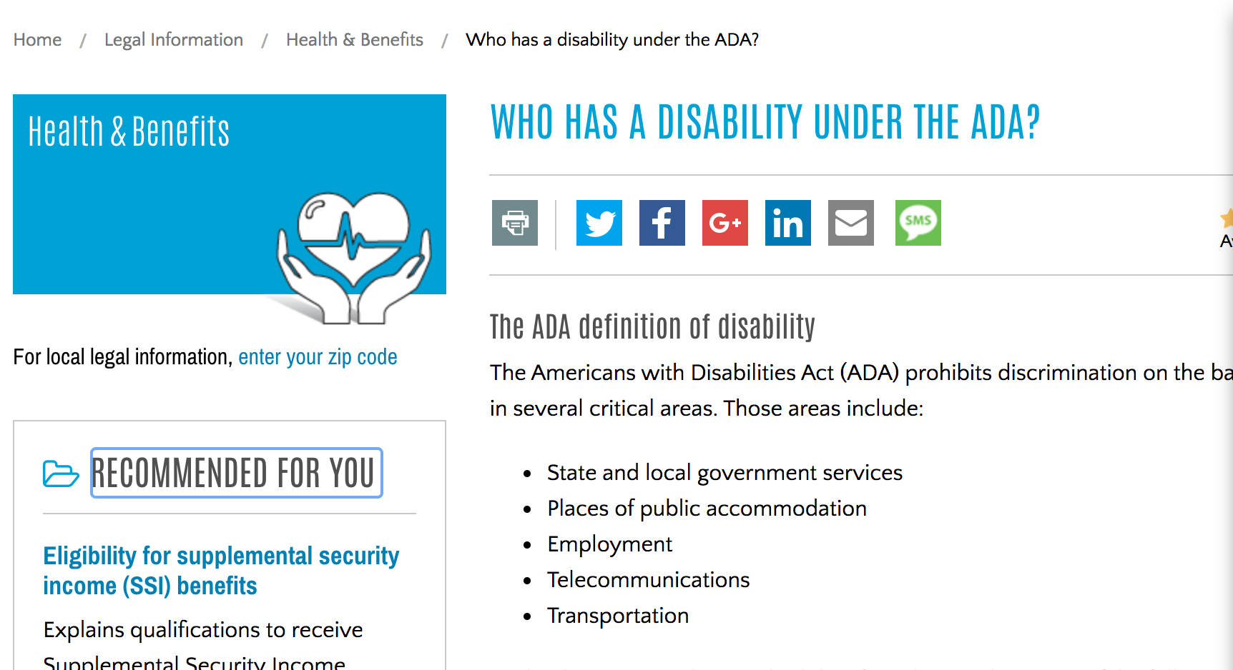
Notes:
So let’s walk through the visual editor really quickly. I open my variant and then highlight the element I want to modify.

Slide 46
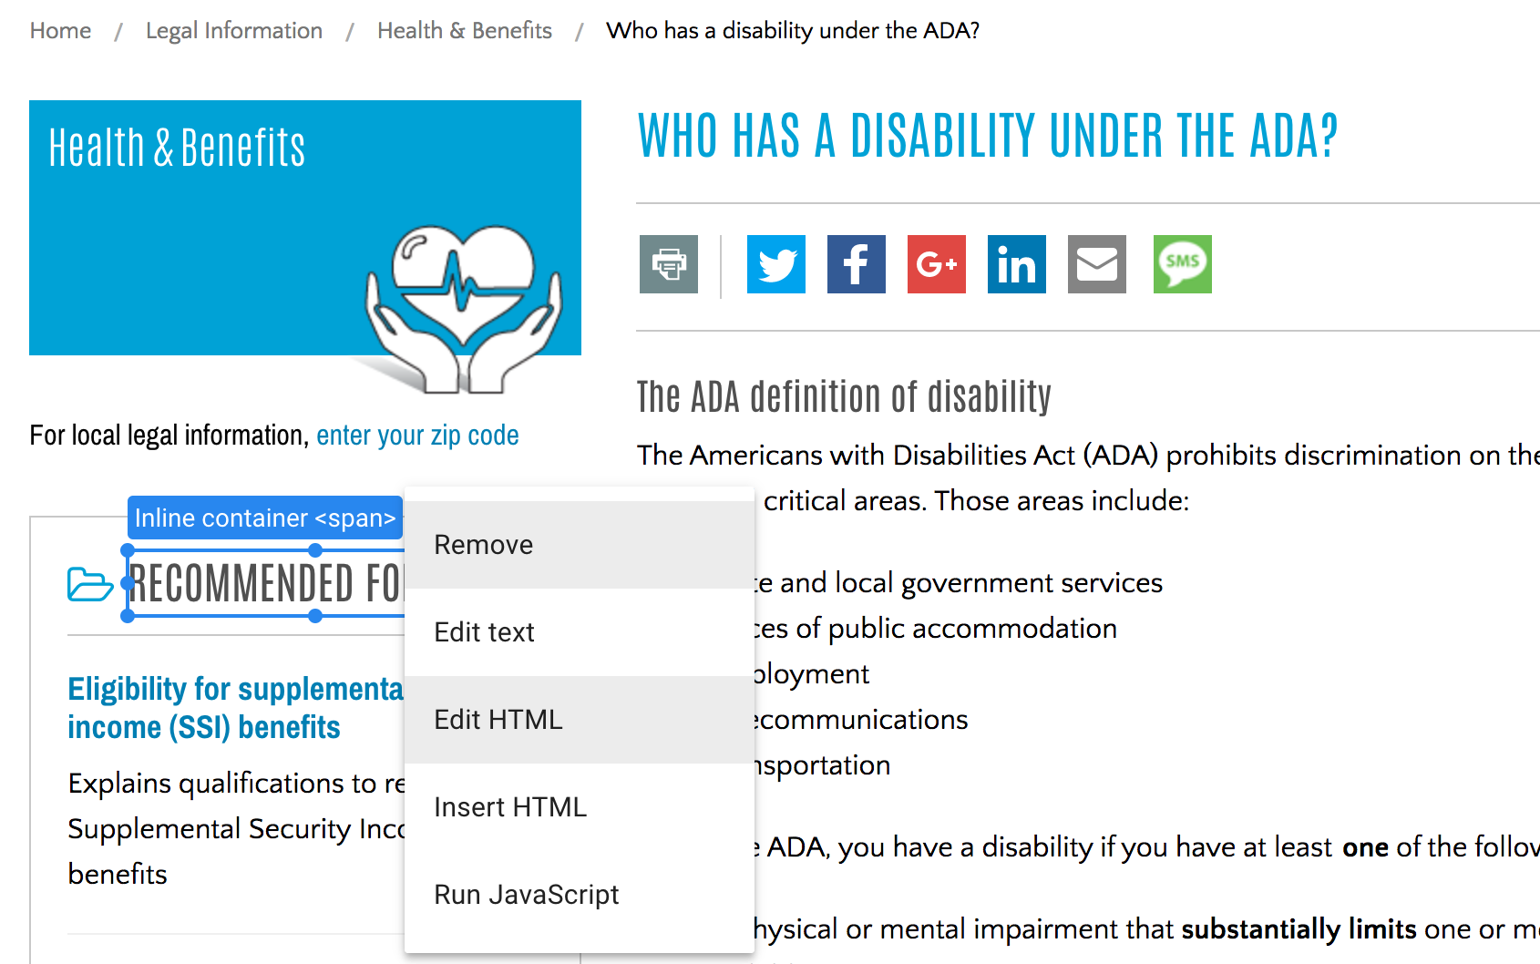
Notes:
I then have options to remove, edit text, edit html, insert HTML, run Javascript. I’m going to edit the HTML. I find that work a little easier to edit text than edit text does.

Slide 47
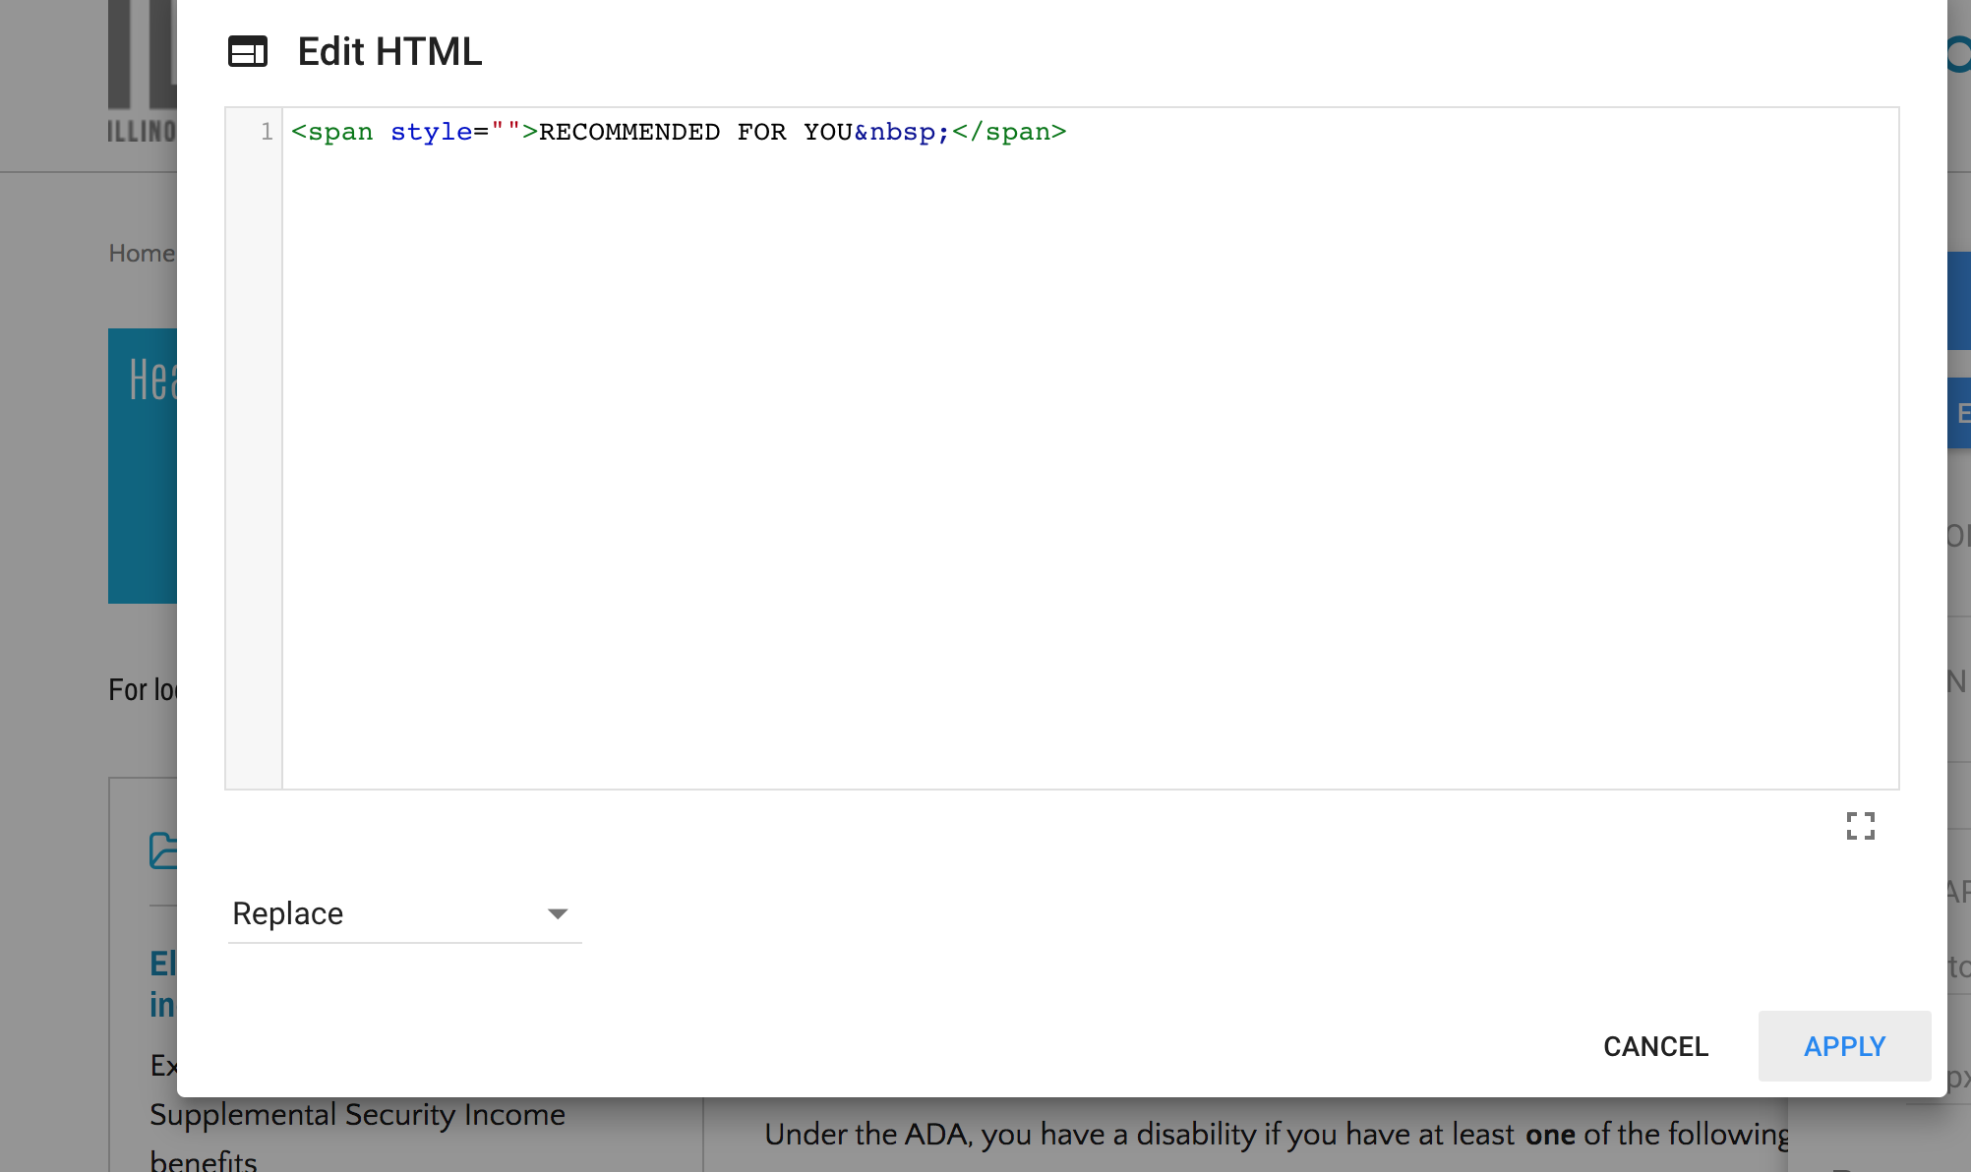
Notes:
And here I can edit the html code and apply it. Then I can save the variant and I am done.

Slide 48
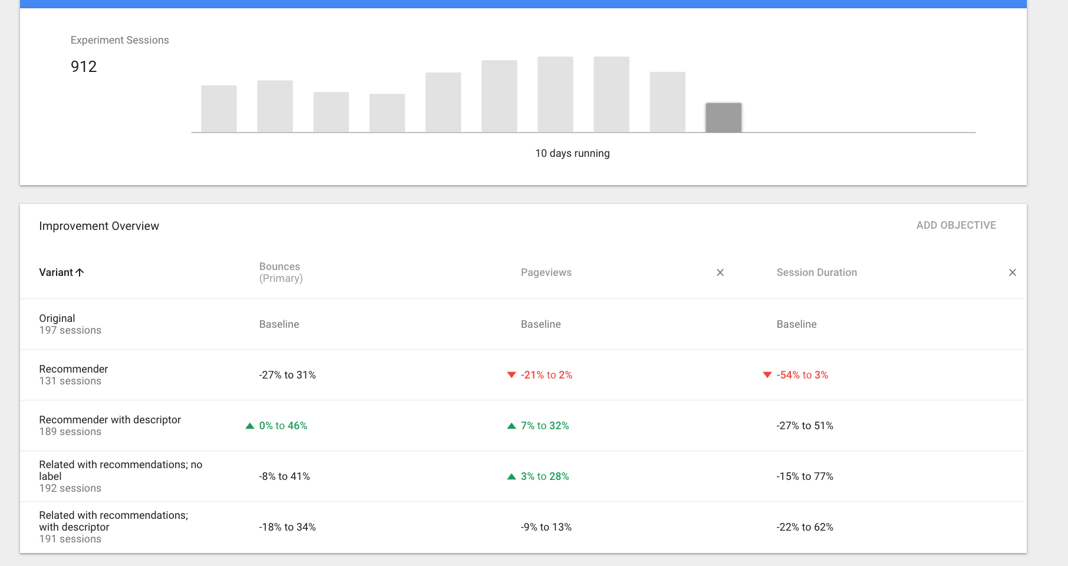
Notes:
One the test has been running, it’ll start reporting results and allows you to see for each of your objectives how the variant compares to the original

Slide 49
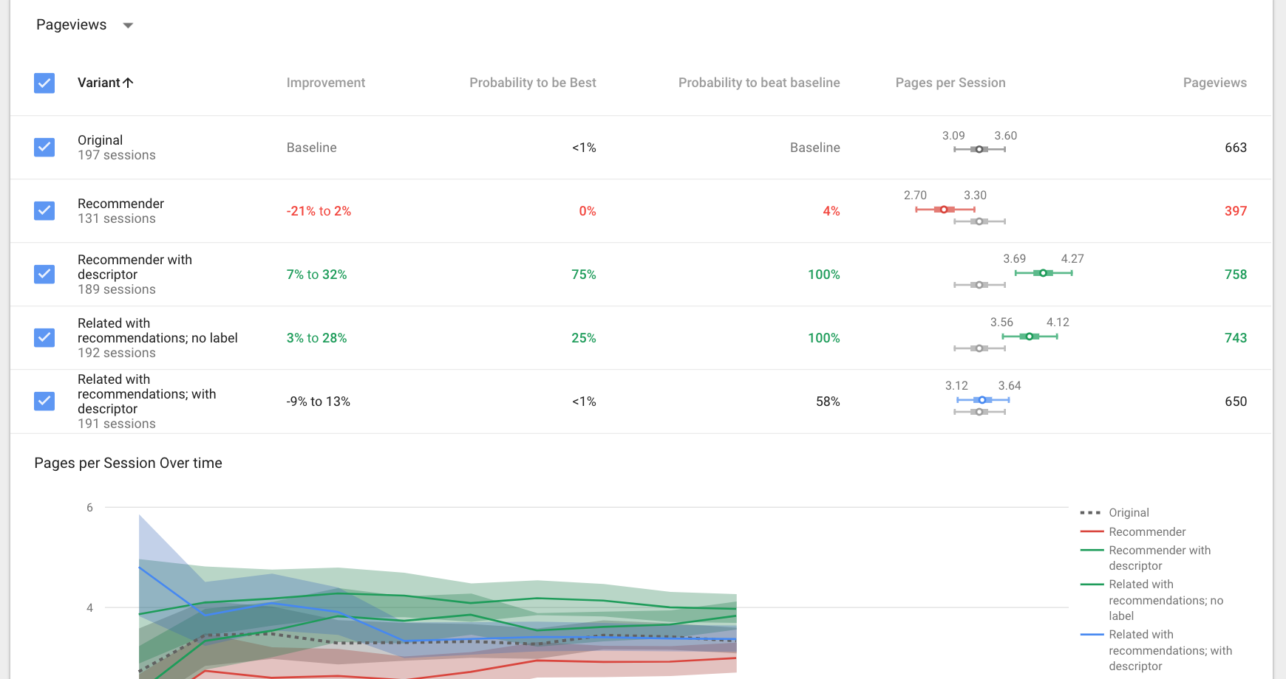
Notes:
Google optimize will also show you a probability that any variant is best or at least better than the baseline.
So here we have 2 variants that are better than the original and one of those is most likely the best.
So now that I've run this test without doing any code work, I can go back to my developers and have them implement the new block.

Slide 50
Observation testing
Notes:
So we’ve talked about a lot of basic tests that can be done fairly easily and cheaply for specific mostly simple things. But really when many of us think about user testing we think about observation testing because nothing will ever beat actually watching a user interact with the website.

Slide 51
Purpose
To see how users interact with the product
To learn why they interact the way they did
To test more complex scenarios
Notes:
Why do we do observation testing? To learn how and why users do what they do and to test more complex scenarios than can be done in a click test, tree test or A/B test.
With any of these tests you really don't get the WHY.

Slide 52
How To Do An Observation Test
5-8 users are enough!
In person
With a paper prototype
With a computer-based clickable prototype
Live site
Online
Google hangouts, GoToMeeting, Skype
Validately.com (Validately.com ($2388/year for base plan; nonprofit pricing is about $1000); $10/user for their testers
Notes:
First, observation testing doesn’t require a lot.
So how can we do an observation test? In person where you invite users in or go where users are with a paper prototype or a clickable online prototype or a finished product.
Or you can do it online. We’ve done some user testing with attorney users using GoToMeeting and record their sessions. We’ve also used Validately.com to test finished products. It’s not free and in fact can be quite expensive. But for us, given some of our time constraints, it was well worth it.
And a quick shoutout to 2 prototyping tools we use: Balsamiq Mockups and Axure. Balsamiq offers free licenses to nonprofits and other ”do gooders” and Axure offers a 60% discount for nonprofits.

Slide 53
Short form user testing
Quick tests (under 5 minutes)
Can usually be done for free
Use to test one or two things
Notes:
So now we’re going to talk about the 2 forms of observation testing: short form and long form.
Let’s start with short form. It takes less than 5 minutes to do. You can usually get people to do it for free or with a very small incentive. Michigan used beads and ice cream toppings for 2 short form tests.
And it is designed to test one or two things.

Slide 54
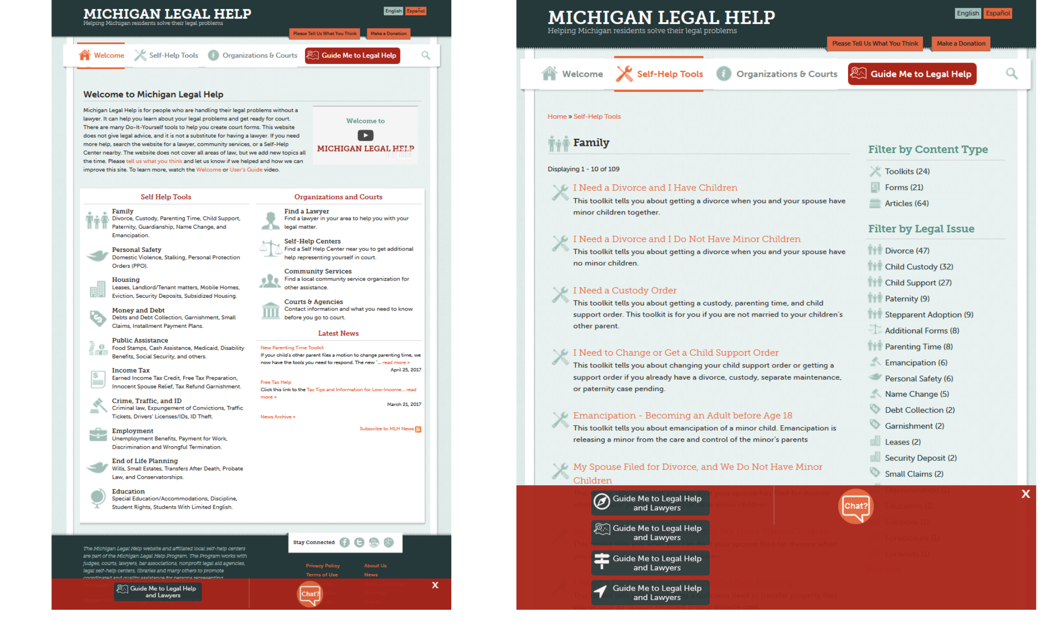
Notes:
For example, Michigan Legal Help did a paper test at Motor City Pride. Testers got mardi gras beads and pens. Michigan Legal Help was already going to be there and threw the test in. It was done by one staff attorney and a law student who just noted answers on a notepad.
Testers were asked to find the guide to legal help (header or footer) then which icon would they use to find help getting legal information and attorney referrals. 5 seconds, super easy, totally free.

Slide 55
Long form user testing
Usually involves whole pages or sections of the website
Expect tests to take 20-30 minutes
Expect to compensate users
Notes:
Long form testing is more complex and requires much more work than short form testing. This is probably what most of us think of as observation testing. It usually involves whole pages, can take 20-30 minutes and we should expect to have to pay users.

Slide 56
Tips for Long Form Observation Testing

Slide 57
Decide what you are testing
What path do users take to do [x]?
On forms: how many questions is too many?
Is this modal annoying?
Do users understand what this icon leads to [y]
Do people use this tool the way we intended?
Notes:
First you need to decide what you are testing. Be narrow. Don’t expect to be able to test a complete website, especially if it is complex in a single test.

Slide 58

Decide where to test
Libraries
Festivals
Restaurants
Anywhere users are
Notes:
Pick a location, secure permission to work there for an hour, a day, whatever you think you’ll need. Think about who your participants will be, and how you’ll attract them - and picking a location that will help you do this. Picking a date and location helps by giving you an external deadline, and helps to get everyone involved to do their part and get it finished. For example, Michigan Legal Help did testing at an ice cream parlor and we’ve done testing at legal help desks at the Daley center downtown.

Slide 59

Make a plan
What do we need?
What are the scenarios?
What are the tasks?
Who needs to be there?
Who is responsible for what?
Notes:
Start to make a plan. There are a lot of moving parts, and its best to sort them into categories and write them down as early as possible. You will modify this plan many times before the day of the user testing.

Slide 60
Suggest scenarios
Ask users to come up with scenarios for themselves, friends, or relatives
Be prepared to offer scenarios if they can’t think of one
Examples:
Imagine you just received divorce papers (on a legal site)
Pretend you want to book a flight to Paris (on a travel site)
Assume you need to buy a gift card for a friend’s birthday (on an e-commerce site)
Notes:
I want to stress the importance of suggesting scenarios. Sometimes you can do user testing just by watching people interact with your system. You can say here you are, use this website. But they may not know where to start, they may not have a reason to use the site or be able to think of one. They may feel shy about using a real-life scenario of their own. However, if you suggest one, they may not really engage in the topic or search like a person who really has that problem. We have found it works best to make some specific scenarios that people can relate to, give them a selection to increase likelihood that they’ll connect with one, and then connect it to a friend or relative. Often, people will start researching a canned scenario, then see something that strikes a chord with them that relates to an actual problem they have, and then become even more engaged. Best case scenario! IT’s always good to have a back up plan in case people can’t think of a reason to use the website.

Slide 61
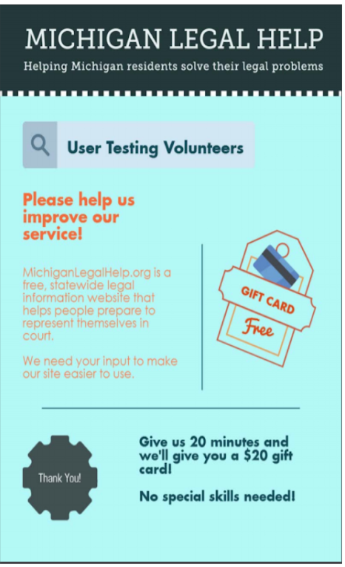
Recruiting and rewarding participants
On your own:
Email
Newsletters
Posters where your users visit
On your website
On the street*
Let platform find you testers
Notes:
You may have to actively recruit participants. We’ve sent emails and posted in our newsletter that we are looking for testers. We’ve reached out to partner legal aid organizations and asked them to send us clients. Michigan recruited people at events with larger crowds…like the Detroit Pride parade and an ice cream parlor.
Figure out how you’re going to reward participants - what kind of payment will get their interest and encourage them to honestly try? We all use a guideline of about $1/minute for long form testing.
Michigan Legal Help gave away Kroger gift cards for long form testing, ice cream toppings for our short form.
Sometimes when time is an issue, online platforms can find testers for you.

Slide 62
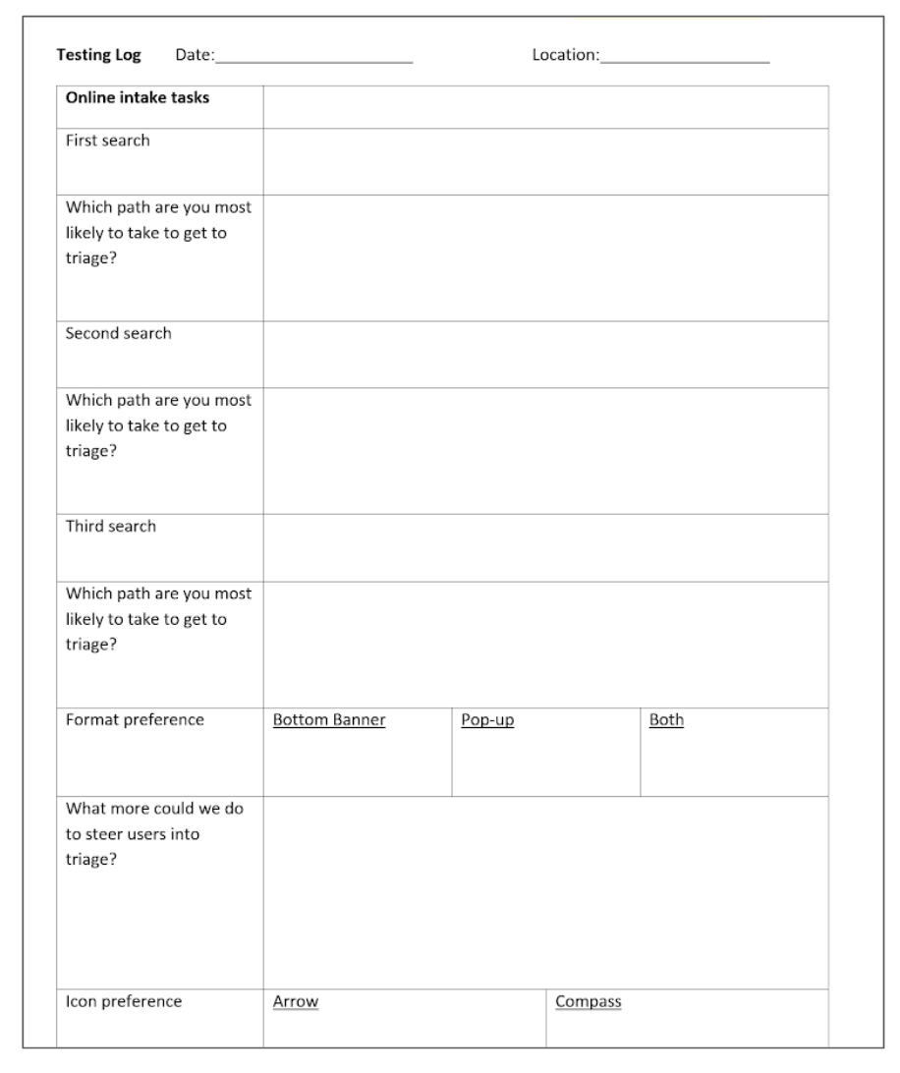
Develop Test Flow
Does your site work?
Do you have scripts?
Documents?
Who needs to be there?
Notes:
Develop your detailed test flow. This is the stage where you make sure your development site or prototype is working the way you intend it to, allowing the testing you’ve planned out.
Write your scripts - this is sort of scientific, so what you say to people and how you present it is important - write a script and stick to it. You’ll also need to prepare a lot of documents: pre and post surveys, scoring sheets, etc.
Decide how many people from your org you will need - typically one person to administer the test and another to make notes, and possibly one to do crowd control. Make sure they can all be there.
Make a sign.

Slide 63

Pre & Post Test Surveys
Pre test: demographics, background with technology and your site/domain Post test: Rate the experience you just had (organization, results, ease of use)
Notes:
Don’t forget too to do a pre and post test survey so that you can capture demographics about your user and give them an opportunity to rate the overall experience.

Slide 64
Test your tests
Family, friends, co-workers can help out
Repeat as needed
Notes:
Test your user test scenario and script on friends, family, co-workers before you get out in the field. Refine it based on what you learn and test again. You don’t want the test date to be the first time you have put your careful plan into action.
You’ll probably also revise your plan after you test. This is important for documentation, and it will really help you for next time. If you make modifications at the live date, make notes of those too - documentation is key here.

Slide 65

Day of testing
Get there early
Set up
Be open to anything!
Notes:
The day has arrived! Get there early, set up, and be open to/prepared for anything! User testing is a lot of things, but it is never dull. In Michigan, doing a test at the library, lots of men from the homeless shelter got really into the testing, and one guy went back to the shelter and brought back a bunch more guys. There was a line for testing! They were in good spirits, brought snacks to share, and were a fun audience.

Slide 66
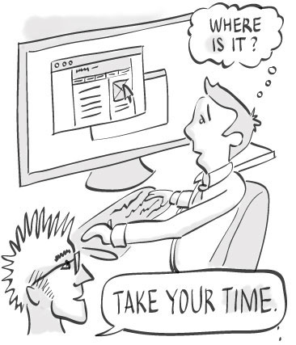
Getting good results
Be clear that you are testing the product, not them
”You won’t hurt our feelings” – give them permission to be critical
Start with easy tasks
Stay out of the way
Debrief
Notes:
A little advice on getting good results:
Put the tester it ease. You are NEVER testing the user. You are testing the product. Encourage them to not worry about hurting our feelings.
When testing, let the participant lead. If they go down a route you wouldn’t expect, let them. You might learn something.
Don’t explain how something works or why it works a specific way. You aren’t going to be around to do that with your users and this might introduce biases.
Don’t interrupt. Encourage the participant to think aloud but try very hard not to interrupt..they’ll lose their flow.
Pay attention to user behavior and body language. Not just what they do.
When the test is done, talk to the participant. Use a post-test survey if appropriate. Ask follow up questions about what they did to learn what their thought process was especialy if they weren’t particularly vocal during the test.

Slide 67
Now What?
Analyze the results
Make recommendations
Score the recommendations
Estimate what it would take to fix
Prioritize
Notes:
All this research and testing is awesome but what do we do with it? It’s not helpful if we can’t or won’t act on it. So our recommendations is to immediately go notes and test resuts and write down all the recommendations you have for changes and improvements.
Score those from high to low priority.
Make time estimates on the fixes, as well as identifying who would be responsible (web firm or us).
With a limited budget for the site build, there were things that may have to be put on a “nice-if” list as improvements or fixes down the road.

Slide 68

Questions? Comments?

